Slide 1
Chapter 5
Basic Computer Organization

Slide 2
Purpose of This Chapter
In this chapter we introduce a basic computer and show how its operation can be specified with register transfer statements.

Slide 3
Instruction Codes
A process is controlled by a program
  A program is a set of instructions that specify the operations, data, and the control sequence
  An instruction is stored in binary code that specifies a sequence of microoperations
  Instruction codes together with data are stored in memory (Stored Program Concept)

Slide 4
Instruction Codes
Instruction Code is a group of bits that instructs the computer to perform a specific operation.
The basic part is the operation part.
  A group of bits that define such operations as add, subtract, multiply, shift and complement.

Slide 5
Program statements and computer instructions
Notes:
5

Slide 6
Simplest stored program organization
Memory
4096x16
15
12
11
0
Opcode
Address
Instructions
Instruction Format
(program)
15
0
Binary Operand
Operands
(data)
Processor register
(Accumulator, AC)

Slide 7
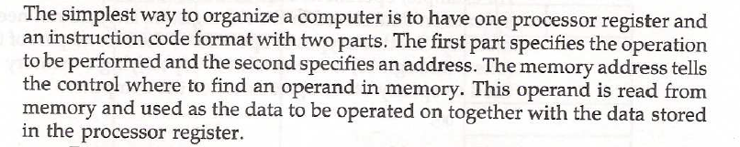
Simplest stored program organization

Slide 8
Instruction code format
Instruction code format with two parts : Op. Code + Address
  Op. Code : specify 16 possible operations(4 bits)
  Address : specify the address of an operand(12 bits)
15 12 11 0
15 12 11 0
Op. Code Address
data
instruction
Not an instruction

Slide 9

  If an operation in an instruction code does not need an operand from memory,[clear AC, Complemet AC, and increment AC] the rest of the bits in the instruction(address field) can be used for other purpose

Slide 10
Addressing Mode
  Immediate operand address :
    the second part of an instruction code(address field) specifies an operand
  Direct operand address :
    the second part of an instruction code specifies the address of an operand
  Indirect operand address :
    the bits in the second part of the instruction designate an address of a memory word in which the address of the operand is found .
      One bit of the instruction code is used to distinguish between a direct and an indirect address :
I=0 : Direct,
I=1 : Indirect

Slide 11
INDIRECT ADDRESS
Instruction codes
Instruction Format
15
14
12
11
0
I
Opcode
Address
Direct Address
Indirect address
22
0
ADD
457
35
1
ADD
300
300
1350
457
Operand
1350
Operand
+
+
AC
AC
Effective Address(EFA, EA)
The address, that can be directly used without modification to access
an operand for a computation-type instruction, or as the target
address for a branch-type instruction
Notes:
The indirect address needs 2 refernces to memory to fetch an operand, the direct address need just 1.

Slide 12
Components of Instructions
Operations (opcodes)
Number of operands (Number of data locations)
opcode:add value in src1 to
value in src2 and place the
result in dst.
ADD R1, R2, R3 R1 ← R2 + R3
Instruction encodings
add r1,r2,r3
opcode
src1
src2
dst

Slide 13
Number of Operands per instruction
No Operands HALT NOP
1 operand NOT R4 R4 ← R4
2 operands ADD R1, R2 R1 ← R1 + R2
3 operands ADD R1, R2, R3 R1 ← R2 + R3
> 3 operands MADD R4,R1,R2,R3 R4 ← R1+(R2*R3)
Each specify one operation and 1,2, 3 or 4 data locations.
Notes:
13

Slide 14
Instructions are read from memory as words
Instructions can be formatted to fit in one or more memory words.
An instruction may contain
  An opcode + data (immediate operand)
  An opcode + the address of data (direct addressing)
  An opcode + an address where the address of the data is found (indirect addressing)
  Data only (location has no instructions)
  An opcode only (register-reference or input/output instruction)
Notes:
14

Slide 15
Building A Basic Computer!
The basic computer instructions are stored in the memory
The size of each memory word is 16 bits.
Each instruction occupy one word.
1. Memory
address
contents
0000000000000001
0000000000000010
0000000000000011
0000000000000100
0000000000000101
0000000000000110
0000000000000111
0000000000001000
0101010101010101
1010101010101010
1100110011001100
0011001100110011
0101010101010011
1010101010101010
1100110011001100
0011001100110011
2. Program Counter
PC
000000000001
3. Instruction Register
IR
0101 010101010101

Slide 16
The address register is connected to the memory
+1
The Program Counter points to the next address of the program
PC
000000000010
0 0 0 0 0 0 0 1
Program Counter Increments
by units of addresses
AR
000000000010
2. The next address is put on the bus and is loaded into the Address Register
Direct access to Memory
3. The Bits of the AR are wired directly to the RAM Address lines to enable loading the memory into the Instruction R.
IR
1010101010101010

Slide 17
Direct address
Occurs When the Operand Part Contains the Address of Needed Data.
1. Address part of IR is placed on the bus and loaded back into the AR
2. Address is selected in memory and its Data placed on the bus to be loaded into the Data Register to be used for requested instructions

Slide 18
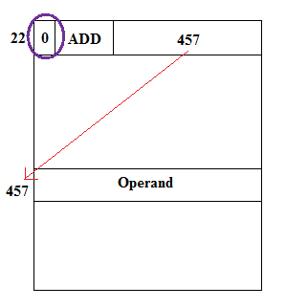
Direct address

Slide 19
Indirect address
Occurs When the Operand Contains the Address of the Address of Needed Data.
1. Address part of IR is placed on the bus and loaded back into the AR
2. Address is selected in memory and placed on the bus to be loaded Back into the AR
3. New Address is selected in memory and placed on the bus to be loaded into the DR to use later

Slide 20
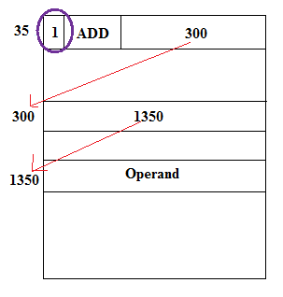
Indirect address

Slide 21
Effective address:
• Effective address: Address where an operand is physically located
Effective address: 457 Effective address: 1350

Slide 22
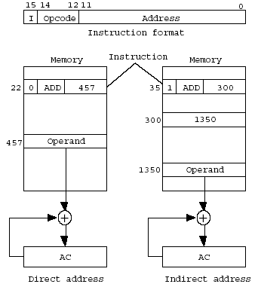
Direct and Indirect addressing example
  Addressing Mode
Notes:
22

Slide 23
Mano’s Computer Figure 5-4
s₀
s₁
s₂
Bus
Memory Unit
4096x16
7
Address
WRITE
READ
AR
1
LD
INR
CLR
PC
2
LD
INR
CLR
DR
3
LD
INR
CLR
Adder
& Logic
E
AC
4
LD
INR
CLR
INPR
IR
5
LD
TR
6
LD
INR
CLR
OUTR
LD
Clock
16-bit common bus
Computer System Architecture, Mano, Copyright (C) 1993 Prentice-Hall, Inc.
Notes:
23

Slide 24
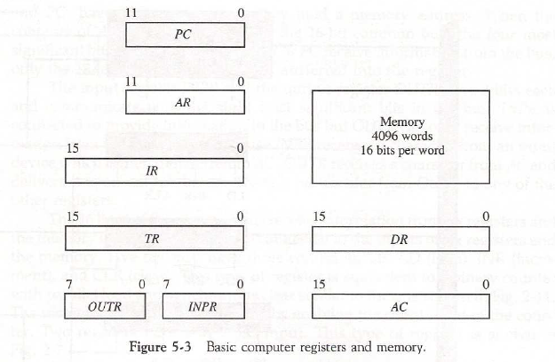
COMPUTER REGISTERS
Registers
Registers in the Basic Computer

Slide 25
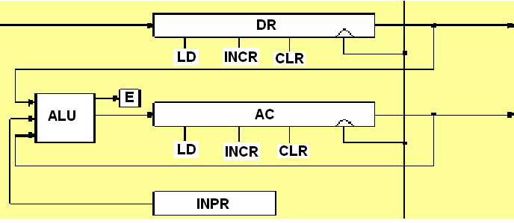
Computer Registers
      Accumulator(AC) : takes input from ALU
        The ALU takes input from DR, AC and INPR :
        ADD DR to AC, AND DR to AC
      Note) Input register is not connected to the bus.
      The input register is connected only to the ALU
Notes:
25

Slide 26
5-2 Computer Registers
Data Register(DR) : hold the operand(Data) read from memory
Accumulator Register(AC) : general purpose processing register
Instruction Register(IR) : hold the instruction read from memory
Temporary Register(TR) : hold a temporary data during processing
Address Register(AR) : hold a memory address, 12 bit width

Slide 27
5-2 Computer Registers
Program Counter(PC) :
    hold the address of the next instruction to be read from memory after the current instruction is executed
    Instruction words are read and executed in sequence unless a branch instruction is encountered
    A branch instruction calls for a transfer to a nonconsecutive instruction in the program
    The address part of a branch instruction is transferred to PC to become the address of the next instruction
    To read instruction, memory read cycle is initiated, and PC is incremented by one(next instruction fetch)

Slide 28
5-2 Computer Registers
Input Register(INPR) : receive an 8-bit character from an input device
Output Register(OUTR) : hold an 8-bit character for an output device

Slide 29
5-2 Computer Registers
Register Number Register Register
symbol of bits name Function-----------------------
DR 16 Data register Holds memory operands
AR 12 Address register Holds address for memory
AC 16 Accumulator Processor register
IR 16 Instruction register Holds instruction code
PC 12 Program counter Holds address of instruction
TR 16 Temporary register Holds temporary data
INPR 8 Input register Holds input character
OUTR 8 Output register Holds output character

Slide 30
Mano’s Computer: each instruction occupies one Memory Words
15
12
11
0
4-bit opcode Bits 15-12
How many possible instructions?
  2⁴=16
This leaves 12 bits for the address
  How many words of memory?
  2¹² = 2²•2¹⁰ = 4K = 4096 16-bit words
Notes:
30

Slide 31
Mano's simple Computer: Instructions
15
12
11
0
Any bits other than 0111 and 1111 are called memory reference instructions
I
000 AND 100 BUN
001 ADD (Branch Unconditional)
010 LDA 101 BSA
(Load Accumulator) (Branch and Store Address)
011 STA 110 ISZ
(Store Accumulator) (Increment and Skip if Zero)
Notes:
31

Slide 33
5-3. Computer Instruction
  3 Instruction Code Formats : Fig. 5-5
    Memory-reference instruction
      Opcode = 000 ∼ 110
        I=0 : 0xxx ~ 6xxx, I=1: 8xxx ~Exxx
        Register-reference instruction
      7xxx (7800 ~ 7001) : CLA, CMA,
      Input-Output instruction
      Fxxx(F800 ~ F040) : INP, OUT, ION, SKI,
I=0 : Direct,
I=1 : Indirect
15 14 12 11 0
I Opcode Address
15 14 12 11 0
0 1 1 1 Register Operation
15 14 12 11 0
1 1 1 1 I/O Operation

Slide 34
Common Bus System
The basic computer has eight registers, a memory unit, and a control unit.
Paths must be provided to transfer information from one register to another and between memory and registers
A more efficient scheme for transferring information in a system with many registers is to use a common bus.

Slide 35
Mano’s Computer Figure 5-4
s₀
s₁
s₂
Bus
Memory Unit
4096x16
7
Address
WRITE
READ
AR
1
LD
INR
CLR
PC
2
LD
INR
CLR
DR
3
LD
INR
CLR
Adder
& Logic
E
AC
4
LD
INR
CLR
INPR
IR
5
LD
TR
6
LD
INR
CLR
OUTR
LD
Clock
16-bit common bus
Computer System Architecture, Mano, Copyright (C) 1993 Prentice-Hall, Inc.
Notes:
35

Slide 36
Common Bus System
  The connection of the registers and memory of the basic computer to a common bus system :
      The outputs of seven registers and memory are connected to the common bus
      The specific output is selected by mux(S0, S1, S2) :
        Memory(7), AR(1), PC(2), DR(3), AC(4), IR(5), TR(6)
        When LD(Load Input) is enable, the particular register receives the data from the bus
      Control Input : LD, INC, CLR, Write, Read

Slide 37
COMMON BUS SYSTEM
Control variables: the bus is controlled by
1- Selection switches for selecting the source of information and
2- Enable switches at the destination device to accept the information.

Slide 38
Selection variables
Selection variables: select a register or the memory whose output is used as an input to the common bus.
To select one device out of 8, we need 3 select variables.
For example, if S2S1S0 = 011, the output of DR is selected as an output of the common bus.

Slide 39
Load input
Load input (LD): Enables the input of a register to download bits form the common bus. When LD = 1 for a register, the data on the common bus is read into the register during the next clock pulse transition.
> Increment input (INR): Increments the content of a register.
> Clear input (CLR): Clear the content of a register to zero.

Slide 40
Incompatibility in register sizes
• When the contents of AR or PC (12 bits) are applied to the 16-bit common bus, the four most significant bits are set to zero. When AR or PC receives information from the bus, only the 12 least significant bits are transferred to the register.
12 least significant bits
12 bits
Notes:
40

Slide 41
IR and TR
The instruction register, IR, can only be loaded; it cannot be incremented nor cleared. Its output is used to generate Di’s and Ti’s control signals.
TR is a temporary register. The CPU uses this register to store intermediate results of operations. It is not accessible by the external programs. It is loaded, incremented and cleared like the other registers.
Notes:
41

Slide 42
Operations involve AC and DR Registers
      Accumulator(AC) : Main Register Microoperation : clear AC, shift AC
      Data Register : ADD DR to AC, AND DR to AC
        3) INPR: Input device
Notes:
42

Slide 43
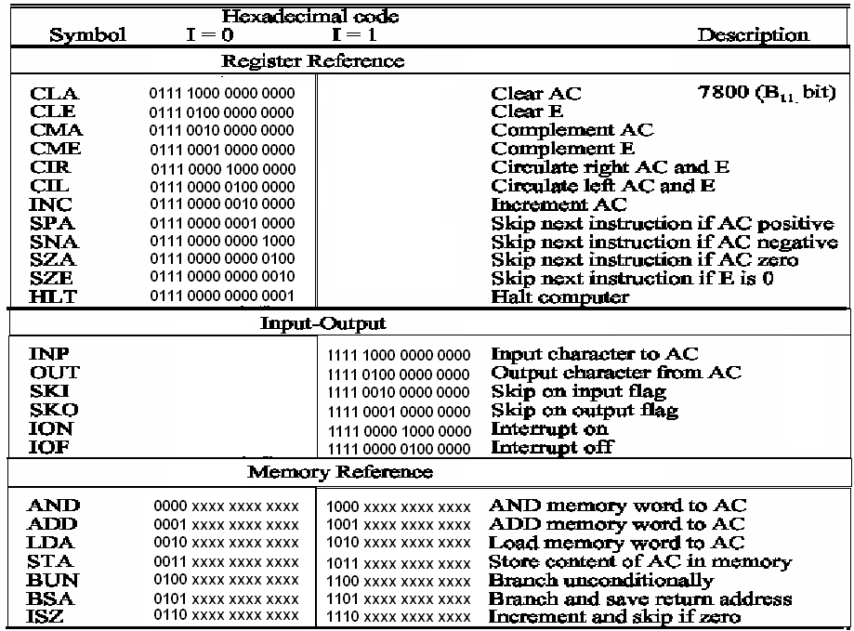
Computer Instruction
3 Instruction Code Formats :
1-Register-reference instruction
      7xxx (7800 ~ 7001) : CLA, CMA, ….
    2-Input-Output instruction
      Fxxx(F800 ~ F040) : INP, OUT, ION, SKI, ….
15 14 12 11 0
0 1 1 1 Register Operation
15 14 12 11 0
1 1 1 1 I/O Operation
3-Memory-reference instruction
  Opcode = 000 ∼ 110
    I=0 : 0xxx ~ 6xxx, I=1: 8xxx ~Exxx
I=0 : Direct,
I=1 : Indirect
15 14 12 11 0
I Opcode Address

